Slide 1

Introduction
Web Development with React & Node
React
Declarative UI
Node.js
Event-Driven API

Slide 2
React: Core Concept & Architecture
What is React?
React is a powerful, open-source JavaScript library developed by Meta (Facebook) for building dynamic user interfaces.
✦Component-Based: Build encapsulated components that manage their own state, then compose them to make complex UIs.
✦Declarative UI: Design simple views for each state in your application, and React will efficiently update and render the right components.
✦Rich Ecosystem: Highly extensible, supporting state management tools, routing libraries, and massive community-driven plugins.
How React Works
React changes how front-end code interacts with the browser by introducing an intermediate rendering optimization layer.
✦The Virtual DOM: Instead of updating the actual DOM directly, React creates an in-memory virtual representation to track UI changes.
✦Efficient Reconciliation: When state changes, React compares the new Virtual DOM with the previous snapshot to calculate the minimum updates needed.
✦One-Way Data Flow: Properties (props) are passed down from parent to child, establishing a predictable, easy-to-debug data cycle.

Slide 3
DOM vs. Virtual DOM
The Real DOM
The Document Object Model (DOM) is the browser's structured, hierarchical representation of the UI elements on a web page.
✦ Tree Structure: It represents HTML tags as a tree of nodes that scripts can dynamically access and manipulate.
✦ Heavy Updates: Any change requires recalculating the layout, CSS, and repainting the entire viewport.
✦ Performance Bottleneck: Frequent direct DOM updates are slow and heavily resource-intensive for modern web applications.
The Virtual DOM
A lightweight, abstract copy of the real DOM maintained completely in-memory by library like React.
✦ Fast Calculations: Changes are first applied to this virtual tree, which is much faster than updating actual browser pixels.
✦ Diffing Algorithm: React compares the updated Virtual DOM with the previous snapshot to isolate exactly what changed.
✦ Batch Reconciliation: Only the precise difference is painted to the real DOM in a single, highly optimized batch update.

Slide 4
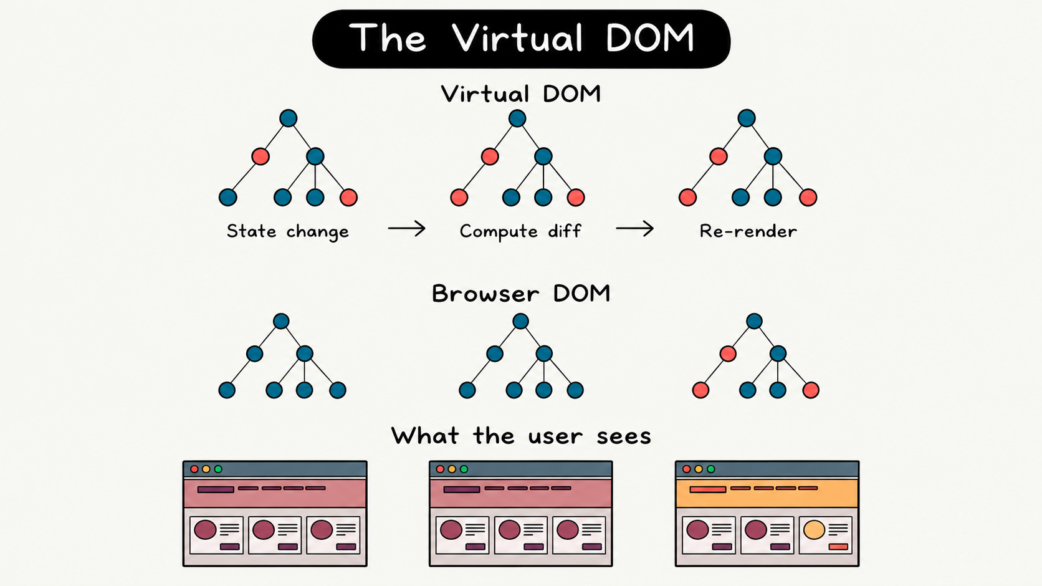

Slide 5

Runtime Environment
What is Node.js?
Node.js is an open-source, cross-platform JavaScript runtime environment that allows developers to execute JS code outside of a web browser.
Key Architecture
✦ Asynchronous & Event-Driven: Uses a non-blocking I/O model, making it lightweight and highly efficient for data-intensive real-time apps.
✦ Single-Threaded Event Loop: Handles thousands of concurrent connections on a single thread without thread-context switching overhead.

Slide 6
Execution Models: Synchronous vs. Asynchronous
Synchronous Execution
✦ Sequential Order: Code is executed line by line, in order. Each operation must complete before the next one can begin.
✦ Blocking Behavior: If an operation takes a long time (like a database query), the entire thread is blocked, preventing any other tasks from running.
✦ Predictable Flow: Easier to design and debug since execution follows a strict, step-by-step linear timeline.
Asynchronous Execution
✦ Concurrent Design: Multiple tasks can start, run, and complete in overlapping time periods without waiting for others.
✦ Non-Blocking I/O: Slow operations are handed off to the system. The main execution thread remains free to respond to other events.
✦ High Efficiency: Ideal for highly concurrent, data-intensive, and real-time operations (such as Node.js applications).

Slide 7
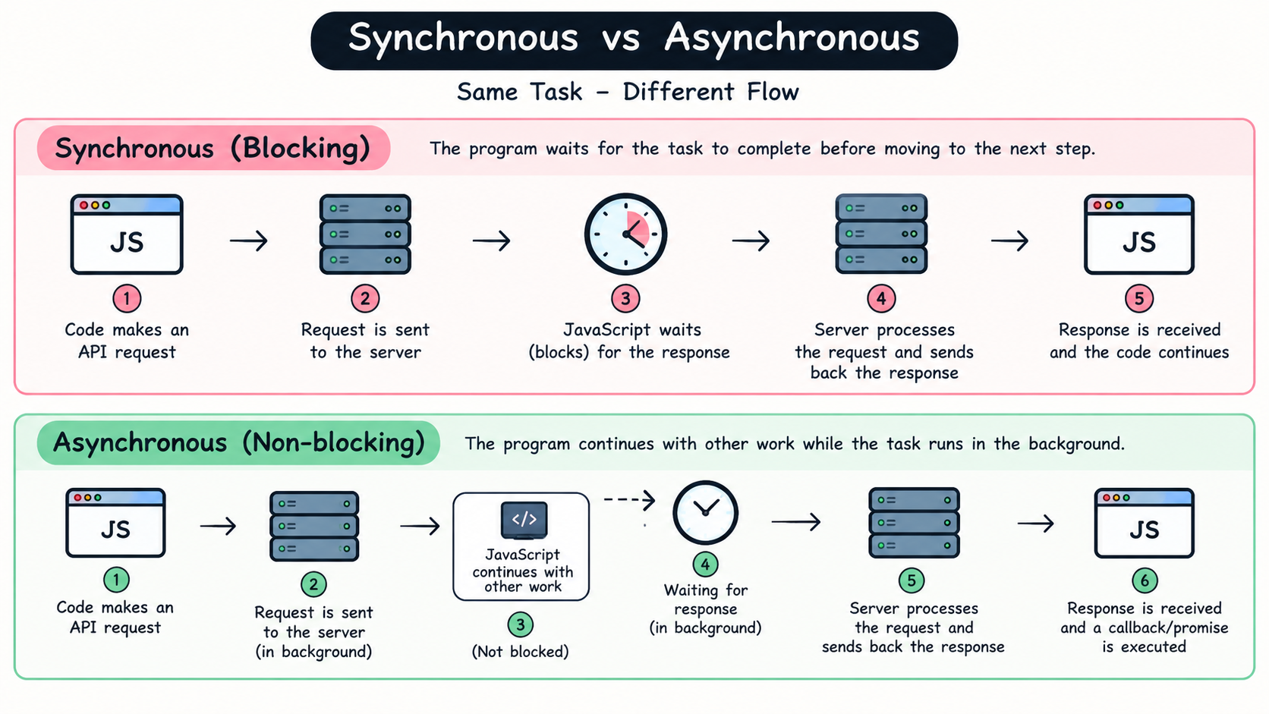

Slide 8
React Folder Structure: Standard Architecture
A basic, industry-standard structure is ideal for lightweight applications. It organizes essential files into public and source directories while keeping a clean and easy-to-navigate module setup.
Basic (Standard) Structure
my-app/
├── public/
└── src/
├── assets/ # Global static files
├── components/ # Reusable global UI
├── Button.jsx
└── Header.jsx
├── hooks/ # Custom React hooks
├── App.jsx # Main entry component
└── main.jsx # Application root

Slide 9
Thank you.

